Slide 1
C# BASICS AUTOMATION
GABRIEL CARABAT, October 2018

Slide 2
AGENDA
.Net and C#
Data Types
Conditional statements
Flow control
First C# program
Visual studio installation

Slide 3
.Net & C#
The .Net framework is a software development platform developed by Microsoft
The framework was meant to create applications, which would run on the Windows Platform
The first version of the .Net framework was released in the year 2002
Form-based and Web-based applications
Web services can also be developed using the .Net framework
Supports various programming languages such as Visual Basic and C#
The "Common Language Infrastructure" or CLI is a platform on which the .Net programs are executed
The .NET Framework includes a set of standard class libraries
A class library is a collection of methods and functions that can be used for the core purpose
Compiler – There is a compiler which will be separate for each programming language
Common Language Infrastructure deals with:
Exception Handling - Exceptions are errors which occur when the application is executed
Garbage Collection - Garbage collection is the process of removing unwanted resources when they are no longer required.
various programming languages

Slide 4
.Net & C#
A class library with methods to handle all file-level operations
Method which can be used to read/write the text from a file
the methods are split into either the System.* or Microsoft.* namespaces.
WinForms – This is used for developing Forms-based applications, which would run on an end user machine
- Notepad is an example of a client-based application.
ASP.Net – This is used for developing web-based applications, which are made to run on any browser such as Internet Explorer
Chrome or Firefox.
The Web application would be processed on a server, which would have Internet Information Services Installed
Internet Information Services or IIS is a Microsoft component which is used to execute an Asp.Net application
The result of the execution is then sent to the client machines, and the output is shown in the browser
ADO.Net – This technology is used to develop applications to interact with Databases such as Oracle or Microsoft SQL Server
Microsoft always ensures that .Net frameworks are in compliance with all the supported Windows operating systems

Slide 5
.Net & C#
.Net Framework Design Principle
Interoperability - The .Net framework provides a lot of backward support. Suppose if you had an application built on an older version
of the .Net framework, say 2.0. And if you tried to run the same application on a machine which had the higher version of the
.Net framework, say 3.5. The application would still work.
Portability- Applications built on the .Net framework can be made to work on any Windows platform.
Microsoft is also envisioning to make Microsoft products work on other platforms, such as iOS and Linux.
Security - The .NET Framework has a good security mechanism
Memory management - The Common Language runtime does all the work or memory management.
The .Net framework has all the capability to see those resources, which are not used by a running program.
This is done via a program called the "Garbage Collector" which runs as part of the .Net framework.
The garbage collector runs at regular intervals and keeps on checking which system resources are not utilized,
and frees them accordingly.

Slide 6
C# data types
Value type variables can be assigned a value directly. They are derived from the class System.ValueType
The reference types do not contain the actual data stored in a variable, but they contain a reference to the variables
Pointer type variables store the memory address of another type
An Integer data types are used to work with numbers.
In this case, the numbers are whole numbers like 10, 20 or 30.
A double data type is used to work with decimals. In this case, the numbers are whole numbers like 10.11, 20.22 or 30.33.
In C#, the datatype is denoted by the keyword "Double"
A boolean data type is used to work with Boolean values of true and false. In C#, the datatype is denoted by the Boolean keyword
A String data type is used to work with String values. In C#, the datatype is denoted by the keyword 'String
An enumeration is used in any programming language to define a constant set of values
For example, the days of the week can be defined as an enumeration and used anywhere in the program

Slide 7
C# data types
Type conversion is converting one type of data to another type. It is also known as Type Casting
Implicit type conversion − These conversions are performed by C# in a type-safe manner
For example, are conversions from smaller to larger integral types and conversions from derived classes to base classes
Explicit type conversion − These conversions are done explicitly by users using the pre-defined functions.
Explicit conversions require a cast operator
A variable is a name given to a storage area that is used to store values of various data types
Each variable in C# needs to have a specific type, which determines the size and layout of the variable's memory
A variable can be of the type String, which means that it will be used to store a string value.
Based on the data type, specific operations can be carried out on the variable

Slide 8
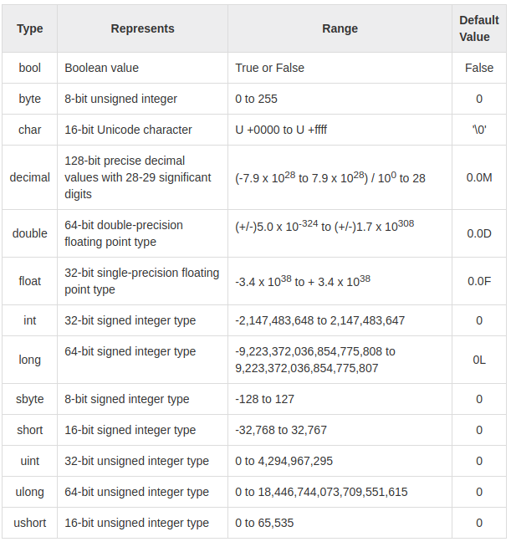

Slide 9
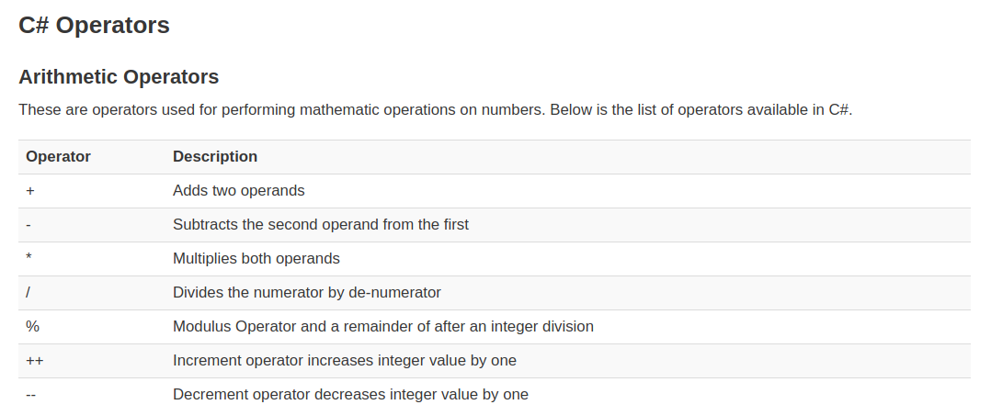

Slide 10
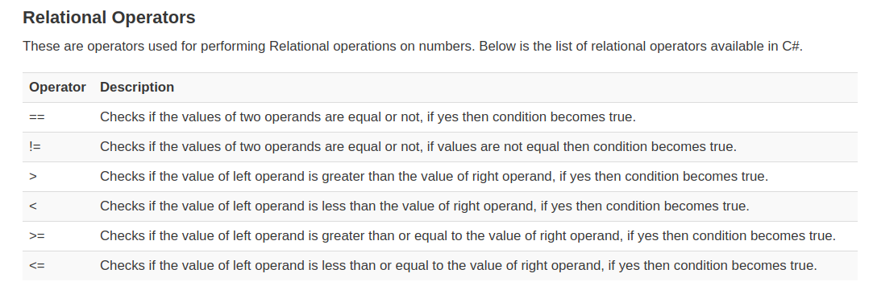

Slide 11
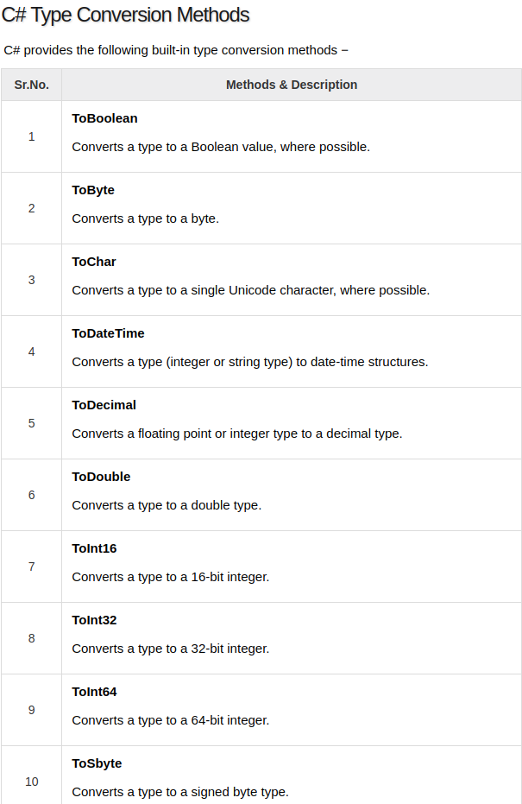

Slide 12
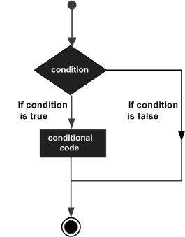
Conditional statements

Slide 13
Conditional statements
An if statement consists of a boolean expression followed by one or more statements
if...else statement
An if statement can be followed by an optional else statement, which executes when the boolean expression is false
nested if statements
You can use one if or else if statement inside another if or else if statement(s)
switch statement
A switch statement allows a variable to be tested for equality against a list of values
nested switch statements
You can use one switch statement inside another switch statement(s)
The ?: operator (ternary operator) Exp1 ? Exp2 : Exp3
The value of a ? expression is determined as follows: Exp1 is evaluated
If it is true, then Exp2 is evaluated and becomes the value of the entire ? expression
If Exp1 is false, then Exp3 is evaluated and its value becomes the value of the expression

Slide 14
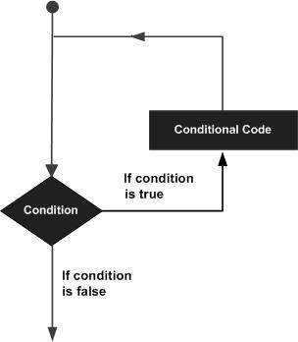
Flow control

Slide 15
Flow control
there may be a situation, when you need to execute a block of code several number of times
while loop
It repeats a statement or a group of statements while a given condition is true. It tests the condition before executing the loop body.
for loop
It executes a sequence of statements multiple times and abbreviates the code that manages the loop variable.
do...while loop
It is similar to a while statement, except that it tests the condition at the end of the loop body
nested loops
You can use one or more loop inside any another while, for or do..while loop

Slide 16
Bonus
https://docs.microsoft.com/en-us/dotnet/csharp/index
Debugging
https://code.visualstudio.com/shortcuts/keyboard-shortcuts-windows.pdf

